Slide 1
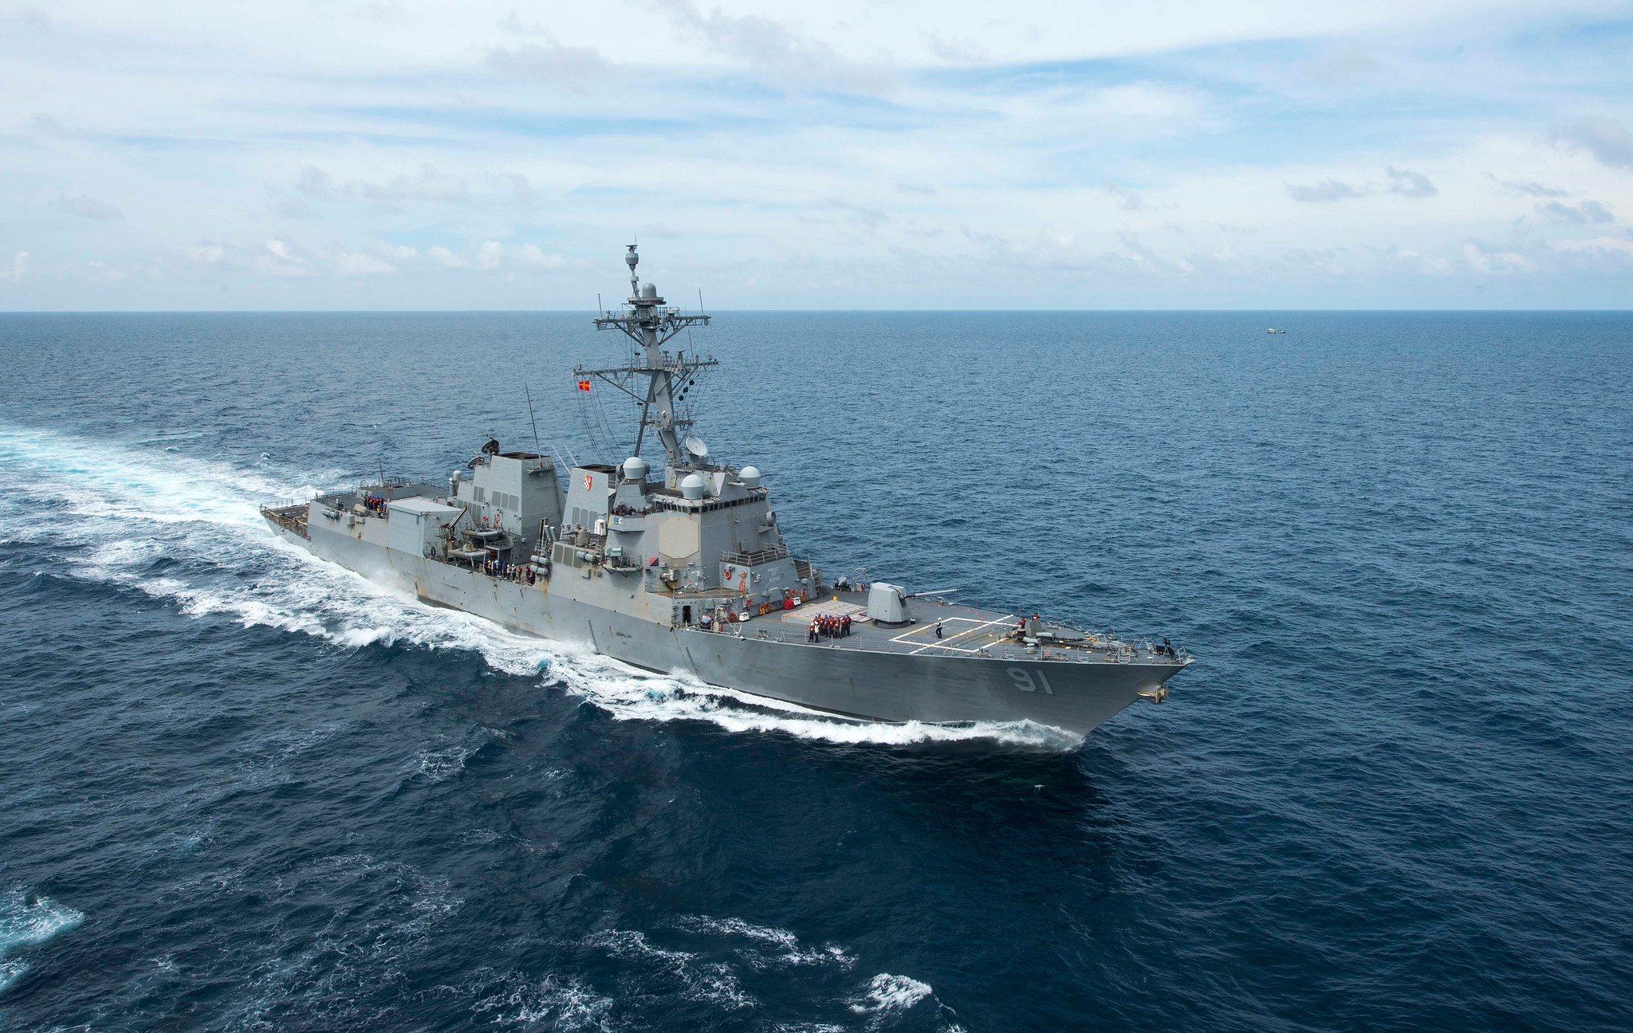
Welcome to Naval Science III
Senior Chief Findall

Slide 2
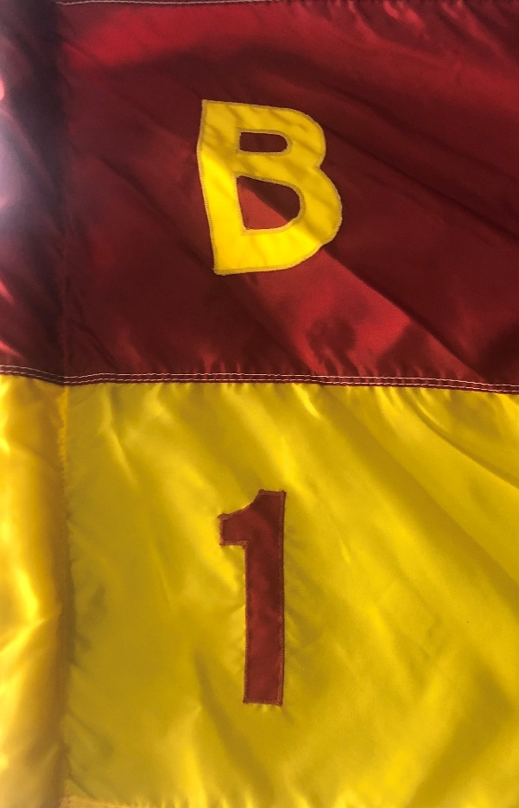
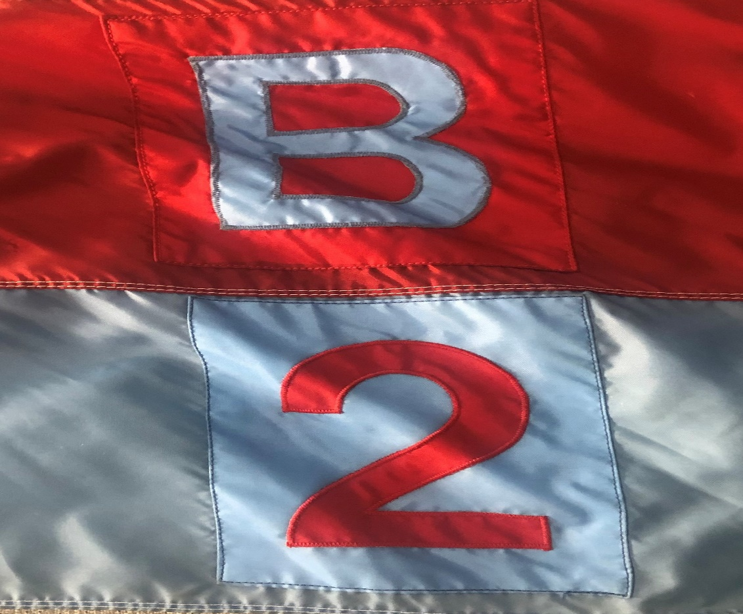
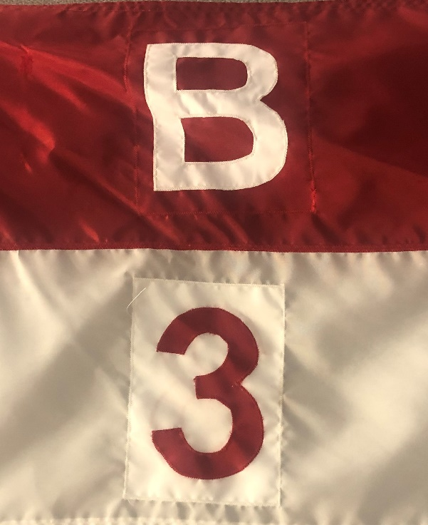
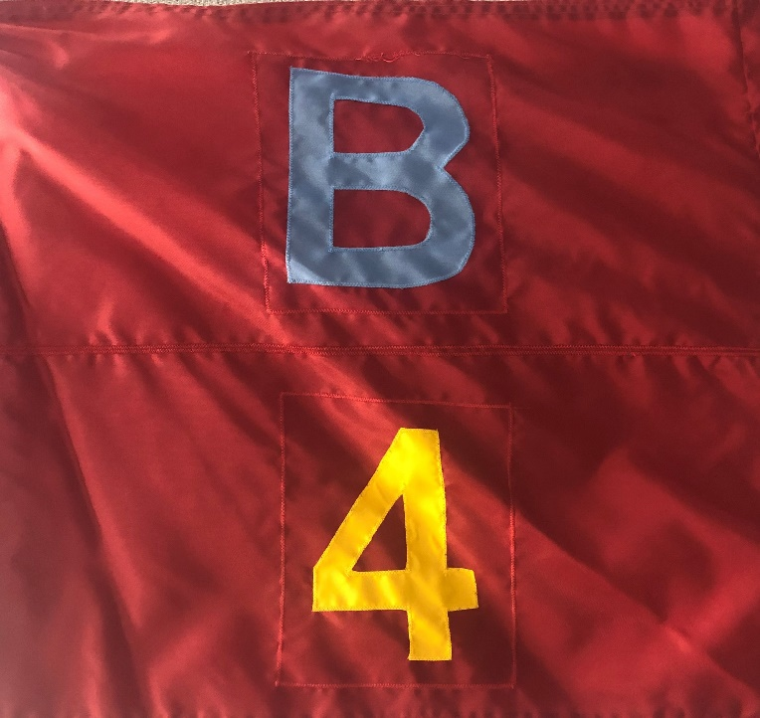

Slide 3
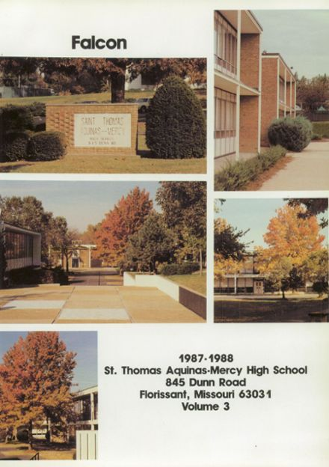
A Humble Beginning In Florissant!

Slide 4
The Start of the Adventure! Chicago in December!

Slide 5
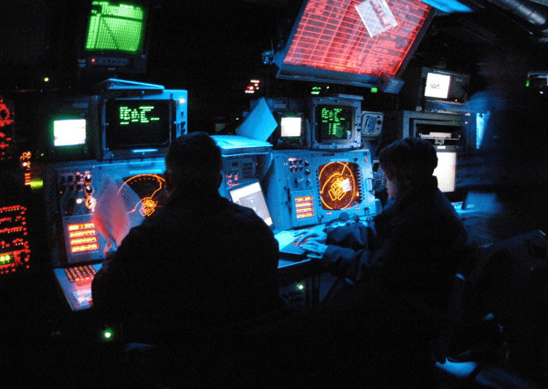
This is how I saw the world. In a room that was always blue and 60 degrees cool.

Slide 6
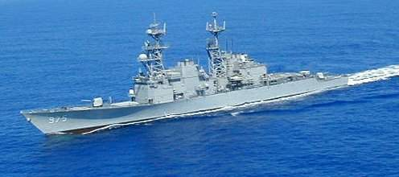
USS O’BRIEN (DD 975)
Homeported in Yokosuka, Japan

Slide 7
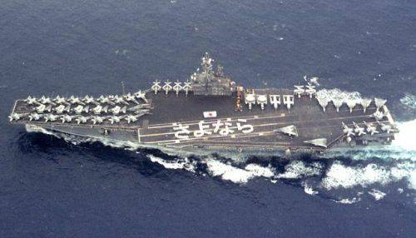
USS INDEPENDENCE (CV 62)
My only Carrier!
Homeported in Yokosuka, Japan

Slide 8
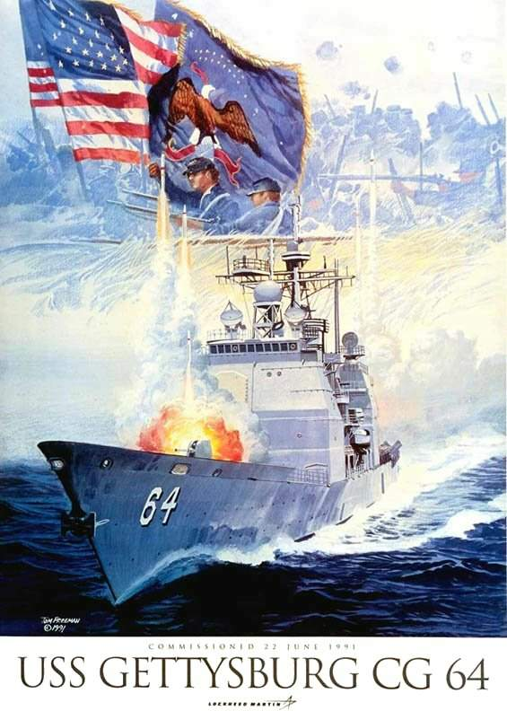
Homeported in
Mayport, Florida

Slide 9
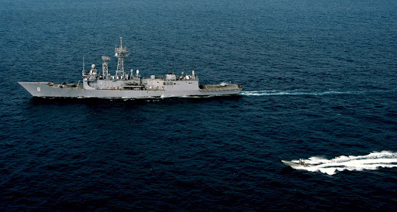
USS McINERNEY (FFG 8)
Captured Drug Runner Boat
(6 Tons of pure Cocaine off the streets)
Homeported in Mayport, Florida

Slide 10
My First Shore Duty, it took 11 years of sea duty to see what I was missing.

Slide 11
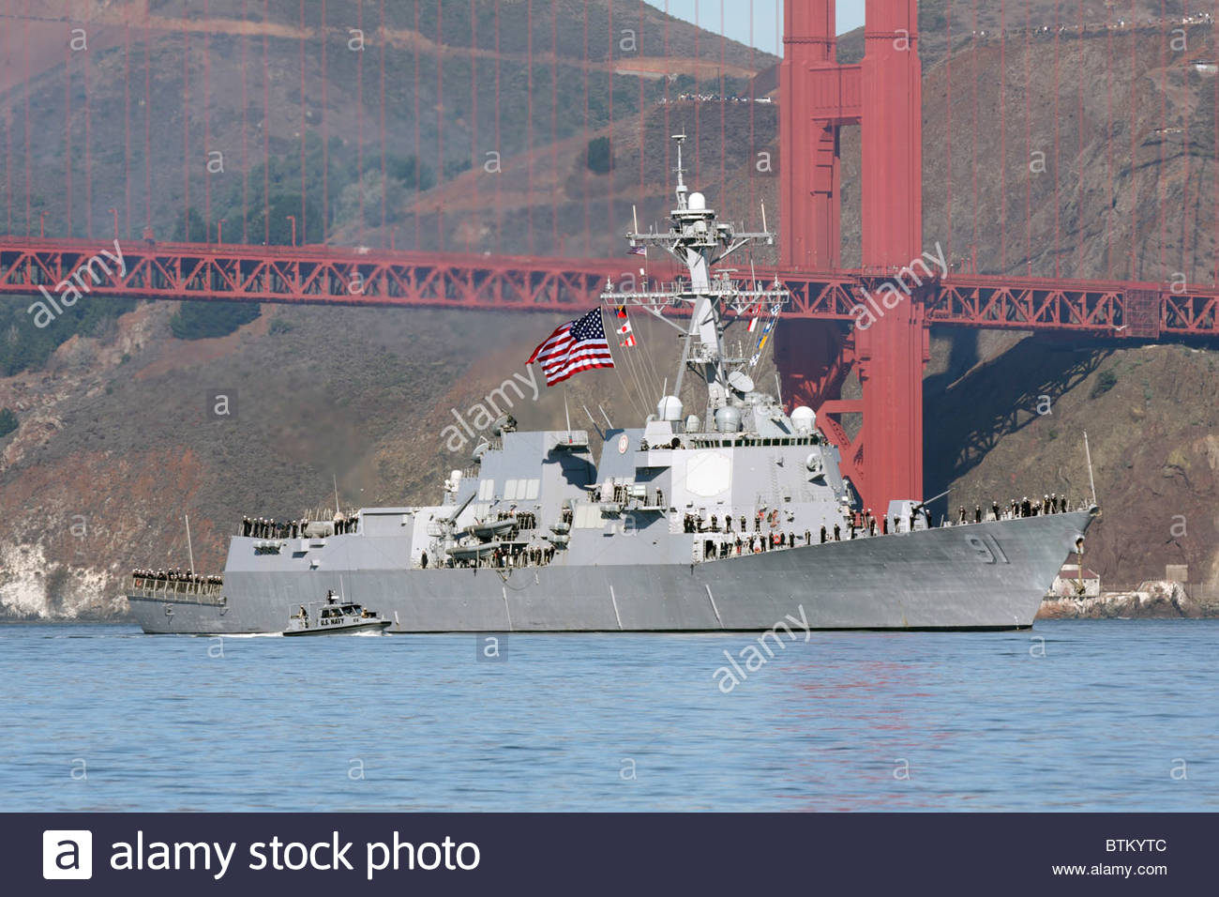
USS PINCKNEY (DDG 91)
If you look Close, I’m standing Infront of Mount 51 (The big 5 inch Gun)
Homeported in San Diego, California

Slide 12
Detachment San Diego, California
Training Ballistic Missile Defense to ships.

Slide 13
Been teaching at Cleveland since September 2014

